Slide 1
inclusive innovation and education
Stéphan Vincent-Lancrin
Project Leader and Senior Analyst
OECD Centre for Educational Research and Innovation (CERI),
Directorate for Education and Skills

Slide 2
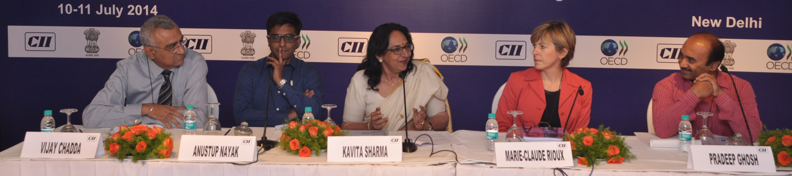
OECD-India international workshop on inclusive innovation in education (New Delhi, July 2014)
Survey on inclusive innovation examples across countries
Collaborative workshop with Planning Commission and CII: About 60 participants from 13 countries discussed a variety of projects, the conditions for their success and the types of policy support they would require
Summary report and presentations on oecd.org/edu/innovation
Some conclusions: call for more multi-dimensional interventions, involvement of communities from the start, more knowledge diffusion initiatives and innovation networks, more support for project evaluation

Slide 3
examples of inclusive innovation

Slide 4
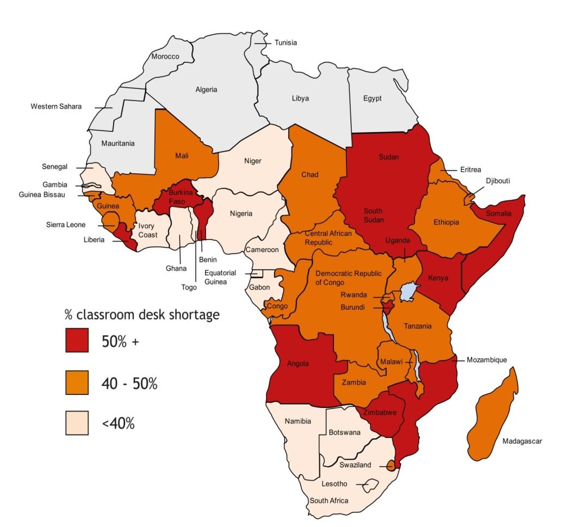
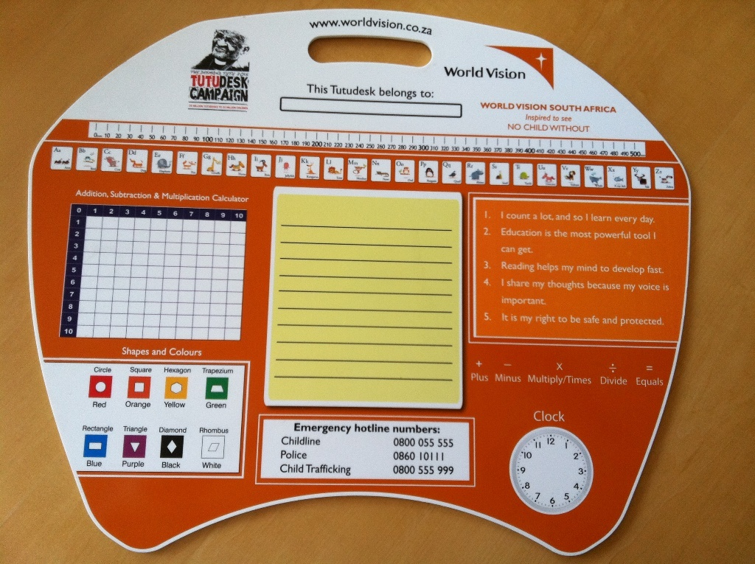
Example 1 : Tutudesk (South Africa)
Problem: 95 million students have no desks for writing in Africa
Solution: Giving solid plastic portable desks that can be used in classrooms and at home
Cost: USD 15, produced in South Africa, distributed in 24 countries, life cycle of 5+ years
Objective: 20 million tutudesks distributed by 2020

Slide 5
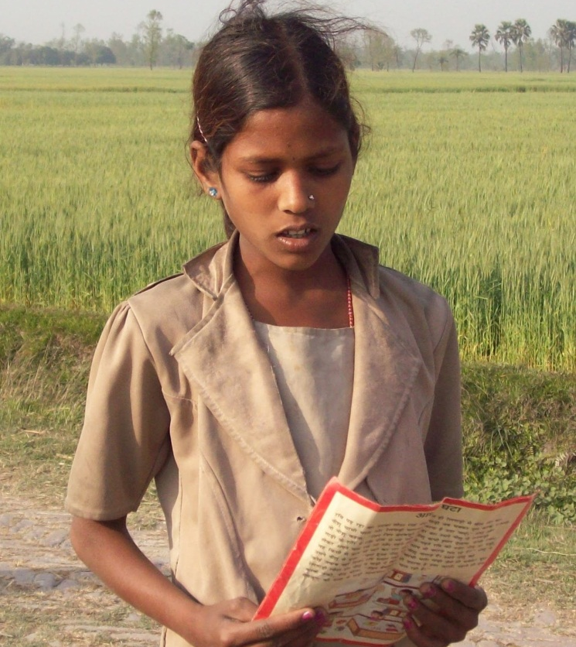

Example 2: Story cards (Pratham books, India)
Pratham story cards are 4-page laminated reading material with the lifetime of a book by reading level
They are sold between 2 and 4 rupees (EUR 0.03)

Slide 6

Example 3: Micro-tuition fees (Omega schools, Ghana)
Chain of low-cost private schools serving low-income populations
“Pay-as-you-learn” daily all-inclusive fee model that fits poor parents’ daily cash flow (as opposed to termly fees)
15 free school days per year to ensure that children are able to attend school on all days

Slide 7

Example 4: Self-sufficient schools (Fundacion Paraguaya, Paraguay)
Model of technical/vocational education for chronically poor young people
Teach vocational and entrepreneurship skills
Low fees but self-sufficient thanks to sales of school enterprises (agricultural products)

Slide 8
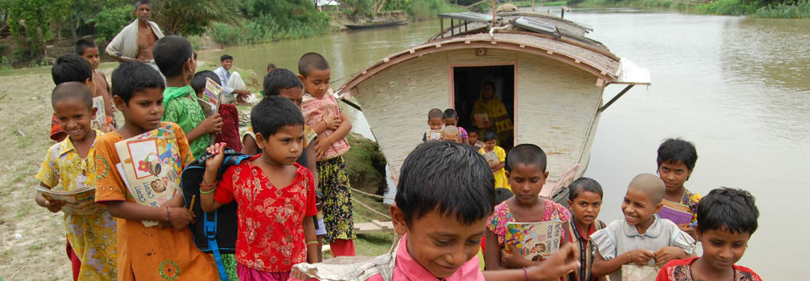
Example 5: Solar-powered floating schools (Shidhulai Swanirvar Sangstha, Bangladesh)
When the moonson does not allow pupils to go to school, solar-powered floating schools pick up pupils in their villages and gives them on-board instruction
Several school shifts, internet connection and solar lamps provided

Slide 9
Example 6: Micro-innovation in school (Majeediya Madarsa-e-Jadeed, Delhi)
Pencil and paper “information system” to track students’ attendance, progress, attitude in and out of school – and, more importantly, change the dialogue with teachers, students and parents

Slide 10
Example 7: Assessment tool used for ASER, for instruction, for engaging parents and teachers (India (Pratham), Pakistan, Kenya, Tanzania, Uganda, Mali and Senegal)
Grade 2 level text
Grade 1 level text
Letters
Simple common words

Slide 11
public-private partnerships

Slide 12
Public support to project implementers
Support knowledge sharing and networking about innovative ideas and innovative project locally, regionally and internationally (Innovation database; meetings; professional development practices at the school/district level)
Innovation prizes and competitive funds targeted to inclusive innovation could help generate new ideas but also make existing interventions more visible (ex: EEF, WISE, etc.)
Evaluation and assessment capacity that project implementers typically miss could be offered by researchers or evaluators and funded through government funding (ex. EEF, J-PAL)
Partnerships between project implementers and governments appear as a key element for the successful scaling up of effective interventions.

Slide 13
Public support to project implementers
It is not enough to support private partners: need to create an innovation ecosystem and stimulate the innovation in the public sector otherwise there will be no implementation of the innovative practices
Need to work with multiple NGOs and a multidimensional reform (ex: Education reforms in Haryana and Bihar)
The problem (for public and private actors) is not just about « obstacles » (lack of funds, health, food, resources, ideas, etc.) but also about changing preferences and behaviour – of students, parents and teachers
One more A to Anil Gupta’s 4As: Accessability, Availability, Affordability, Augmentability + Appetite (for learning) ?

Slide 14
THANK YOU
Stephan.Vincent-Lancrin@oecd.org
www.oecd.org/edu/innovation

